Slide 1
CMAQ/CRP Overview for DCHC MPO
Copy/paste any of the icons below into your presentation. Please change color to white if using them on a dark background.
Mark Eatman, PE
10/10/2023

Slide 2
What is CMAQ & CRP?
Other slide variations are available. Select Insert above and choose “new slide” to see all the options.
CMAQ/CRP Overview for DCHC MPO
Federal grant programs to fund transportation projects that reduce harmful emissions
CMAQ → Congestion Mitigation and Air Quality
Began in 1992
Intermodal Surface Transportation Efficiency Act (ISTEA)
GOAL = Reduce CO, PM_{2.5}, PM₁₀, VOC, NO_{X}
~$50M/year
~$27M/year set aside for MPOs/RPOs
_{~$22M/year for statewide use}
CRP → Carbon Reduction Program
Began in 2022
Infrastructure Investment and Jobs Act (IIJA)
GOAL = Reduce CO₂
~$31M/year
~$12M/year set aside for MPOs

Slide 3
What kinds of projects are eligible?
Other slide variations are available. Select Insert above and choose “new slide” to see all the options.
CMAQ/CRP Overview for DCHC MPO
Sidewalks
Greenways/Multi-Use Paths
Adding Turn Lanes
Roundabouts
Other congestion reduction and traffic flow improvements
Intersections only
LED Light Conversion (CRP Only)
Transit improvements
Operational Assistance (CMAQ Only)
Alternative fuels, vehicles, EV chargers
Subject to Buy America requirements
Public education and outreach activities
Transportation management associations
Carpooling and vanpooling
Carsharing
Extreme low temperature cold start program
Training
Inspection and maintenance programs
Innovative project
Diesel engine retrofits and other advanced truck technologies
Idle reduction
Freight and intermodal
Transportation control measures
Travel demand management
Not an
exhaustive list

Slide 4
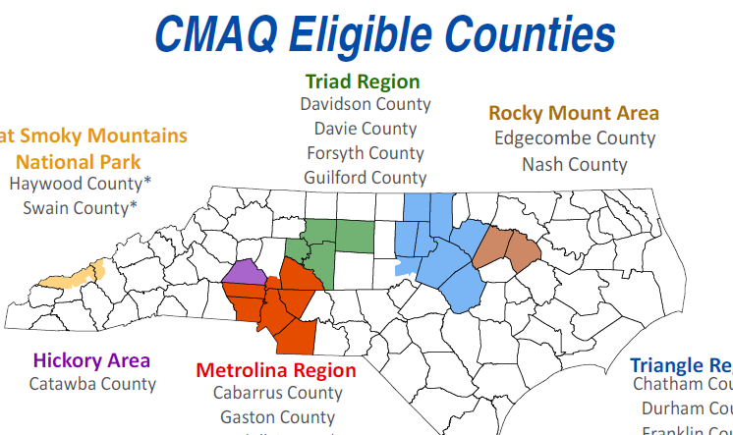
How does CMAQ & CRP impact DCHC?
Other slide variations are available. Select Insert above and choose “new slide” to see all the options.
CMAQ/CRP Overview for DCHC MPO
CMAQ
~$2.3M in Direct Allocation Annually
CRP
~$780K in Direct Allocation Annually
*** Available funding amounts vary from FY to FY ***

Slide 5
Direct Allocation vs. Statewide
Other slide variations are available. Select Insert above and choose “new slide” to see all the options.
CMAQ/CRP Overview for DCHC MPO
MPOs should fully utilize their Direct Allocation (DA) funds each FY
Statewide (CMAQ & CRP) money generally set aside for larger / multiple county projects or education/outreach
NC Rail – Carolinian & Piedmont Operating Assistance
NC Air Awareness Campaign (Department of Environmental Quality)
Clean Fuel Advanced Technology (CFAT) program at NCSU
Transportation Systems Management & Operations (TSMO)
Statewide CMAQ and CRP can be accessed under specific situations:
A small amount above your DA is needed for to complete a project
A project within the MPO is part of a larger statewide effort
Project supplemental funding (inflation, outdate cost estimates, etc.)
Using Statewide money done on a case-by-case basis

Slide 6
Any other things I should know?
Other slide variations are available. Select Insert above and choose “new slide” to see all the options.
CMAQ/CRP Overview for DCHC MPO
Project cost minimum of $100,000 (TOTAL COST)
80% Federal / 20% Local Match is preferred
Can use more local share but needs to be in increments of 5% points (e.g. 25%)
Reimbursement split applies until project is completed
For CMAQ/CRP, locals can use state funds to help with local match
Examples: working with Division 5, use other state grants, etc.
This applies only to projects on the State Highway System
Can’t be used for:
Bike/Ped projects
Transit
City/Private streets
How do I calculate emissions reduction?
FHWA’s Emissions Calculator Toolkit
https://www.fhwa.dot.gov/environment/air_quality/cmaq/toolkit/
Ask me for assistance!

Slide 7
Other slide variations are available. Select Insert above and choose “new slide” to see all the options.
Mark Eatman, PE
mreatman@ncdot.gov
919-707-0970

