Slide 1
Using Federal Funds through NCDOT
Copy/paste any of the icons below into your presentation. Please change color to white if using them on a dark background.

Slide 2
Presentation Overview
PART I : Major Requirements of the Federal Highway Administration (“Big Rocks”)
Applies to all sources of Federal funding (TAP, STBG, CRP, CMAQ, Discretionary Grants (RAISE, Earmarks, etc.)
Requirements have increased over the past 15 years.
PART II : Planning Your Project Proposal (breaking down the “Big Rocks”)
How to factor in Federal requirements
Factors to be aware of that will increase your costs and delay your schedule

Slide 3
Federal Requirements
“Big Rocks”

Slide 4
Federal Highway Administration (FHWA)
Administration of Federal Funds governed by the Stewardship and Oversight Agreement
Outlines responsibilities of NCDOT to provide oversight of funding
Lists those responsibilities that cannot be delegated to the State
Includes detailed requirements for oversight of Local Projects
Title 23 of the Code of Federal Regulations governs Highways

Slide 5
Funding Authorization
FHWA authorizes funding by phases:
Preliminary Engineering (design and environmental documentation)
Right of Way / Utility Relocation
Construction
NCDOT cannot request authorization of funds until certain deliverables are met (23 CFR 630) Project Authorization and Agreements
Any costs incurred prior to funding authorization are not eligible for reimbursement
(23 CFR 1.9(a)) Limit on Federal Participation
T
(23 CFR 1.9(a))

Slide 6
Consultant Procurement
FHWA establishes a process for procurement/administration of consultant contracts that utilize Federal funds:
Selection must be based on qualifications
Consultant rates must be audited by NCDOT
Contract language must include Federal provisions
(23 CFR 172) – Procurement, Management and Administration of Engineering and Design Related Services

Slide 7
National Environmental Policy Act (NEPA)
All Projects must meet requirements of NEPA
Qualified personnel required to complete environmental surveys/assessments
NCDOT must concur with the environmental documents
Documents must be current (less than 1 year old) to authorize funds
(23 CFR 771) – Environmental Impact and Related Procedures

Slide 8
Right of Way
All Right of Way Acquisition must meet the “Uniform Act”
Property owners are entitled to an appraisal
Fair Market Value and Just Compensation is reviewed by NCDOT
ROW requirements apply whether Federal funds are used for ROW or not
(23 CFR 710) – Right of Way and Real Estate
(49 CFR 24) – Uniform Relocation Assistance and Real Property Acquisition for Federal and Federally-Assisted Programs

Slide 9
Construction Contracts
Contract Proposals must include Federal-aid contract provisions:
Davis-Bacon and minimum wage requirements
Disadvantaged Business Enterprises (DBE) goals to utilize minority businesses
Americans with Disabilities (ADA) Act
Buy America – expanded to include construction materials (not just iron and steel)
Title VI, etc.
(23 CFR 633) – Required Contract Provisions

Slide 10
Construction Contract Administration
Advertising, Letting and Awarding Contracts must comply with Federal requirements
Advertisement for 3 weeks
No negotiation with contractor is allowed
NCDOT must concur in the award of contract to the responsible low bidder
NCDOT’s Construction Manual and Standard Specifications will be utilized
(23 CFR 635) – Construction and Maintenance

Slide 11
Multiple Governmental Partners
Other slide variations are available. Select Insert above and choose “new slide” to see all the options.
Keep in mind that you will be dealing with three layers of bureaucracy – local, state, and Federal. The good news is that our office, the Division and FHWA all work together to ensure that all projects meet requirements, and we can reimburse your costs.

Slide 12
Planning Your Project Proposal
Breaking down the “big rocks”

Slide 13
PROJECT DELIVERY
Other slide variations are available. Select Insert above and choose “new slide” to see all the options.
Major Emphasis with NCDOT
Locally Administered Projects (LAPs) are in the STIP – must have a schedule!
When milestones are missed, EVERYONE gets questions
Be REALISTIC when setting schedules
Expect the Unexpected
Project completion occurs after completion of construction – must close out Projects to complete

Slide 14
MAJOR SHOW STOPPERS
Other slide variations are available. Select Insert above and choose “new slide” to see all the options.
FEASIBILITY
POORLY DEFINED SCOPE
CONSTRUCTABILITY
AVAILABLE RIGHT OF WAY
EXTENT OF UTILITY CONFLICTS

Slide 15
MAJOR SHOW STOPPERS
Other slide variations are available. Select Insert above and choose “new slide” to see all the options.
FUNDING
Unrealistic Estimates
Scope Creep (or Scope Reduction)
Inaccurate quantities (or no quantities)
No estimate for Right of Way
No estimate for Utility Relocation
Environmental Issues

Slide 16
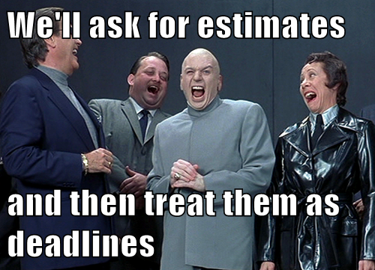
UNREALISTIC ESTIMATES
Other slide variations are available. Select Insert above and choose “new slide” to see all the options.
Do not use bid prices from a previous project
NCDOT publishes average bid prices
Re-advertising issues/problems
Adjusting engineer’s estimate
Negotiating with bidders not permitted
Cost Escalation

Slide 17
RIGHT OF WAY ISSUES
Other slide variations are available. Select Insert above and choose “new slide” to see all the options.
All ROW incorporated into Project must be certified
Must follow the “Uniform Act”
Condemnation
Multiple Property Owners
Title Issues
***This phase always takes longer than you think***

Slide 18
UTILITY ISSUES
Other slide variations are available. Select Insert above and choose “new slide” to see all the options.
Power company will not begin engineering until plans are complete, at least up to Hydro
What about utilities underground (communication, gas, water/sewer)
Most underground utilities are by encroachment
Permanent Utility Easements (PUEs)
Utility /RR Certification
Utilities can get pricey

Slide 19
OTHER ADMINISTRATIVE COSTS
Other slide variations are available. Select Insert above and choose “new slide” to see all the options.
Funds for each phase of work must be authorized prior to any work being performed
PE is around 10-15% of your construction cost
ROW costs can be harder to predict
Contract Administration/Construction Engineering and Inspection (CEI) shouldn’t exceed 15% of construction contract, but exceptions can be made
Review and Oversight Agreements for NCDOT’s review of plans prior to Federal Fund availability
NCDOT COSTS – We will charge to your project, be prepared for NCDOT’s review costs.

Slide 20
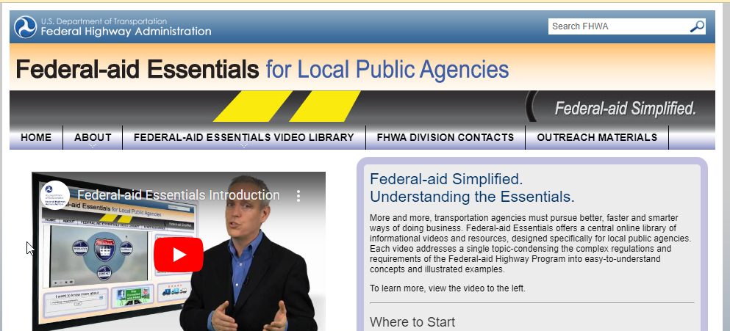
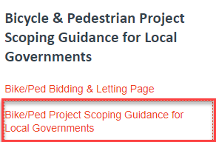
PLANNING RESOURCES FOR PROJECT PROPOSALS
Federal-aid Essentials for Local Public Agencies
https://www.fhwa.dot.gov/federal-aidessentials/
Bicycle and Pedestrian Scoping Guidance
https://connect.ncdot.gov/projects/BikePed/Pages/default.aspx

Slide 21
Project Delivery Resources

Slide 22
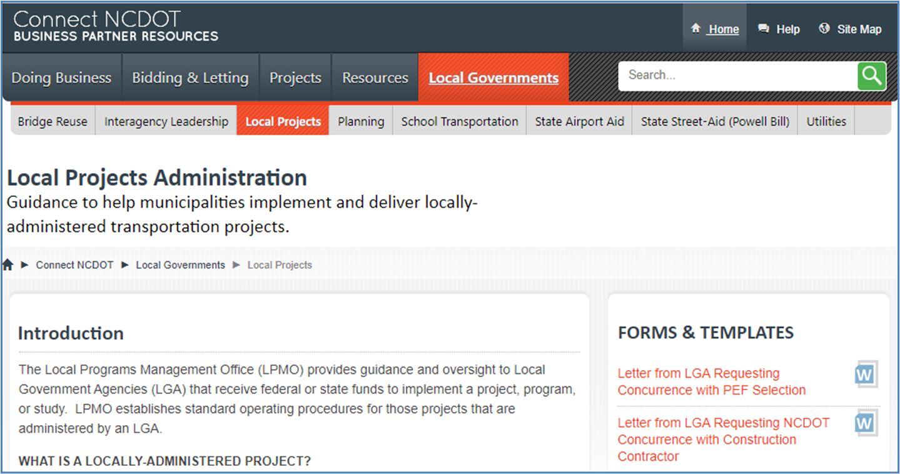
RESOURCES
https://connect.ncdot.gov/municipalities/Funding/Pages/default.aspx

Slide 23
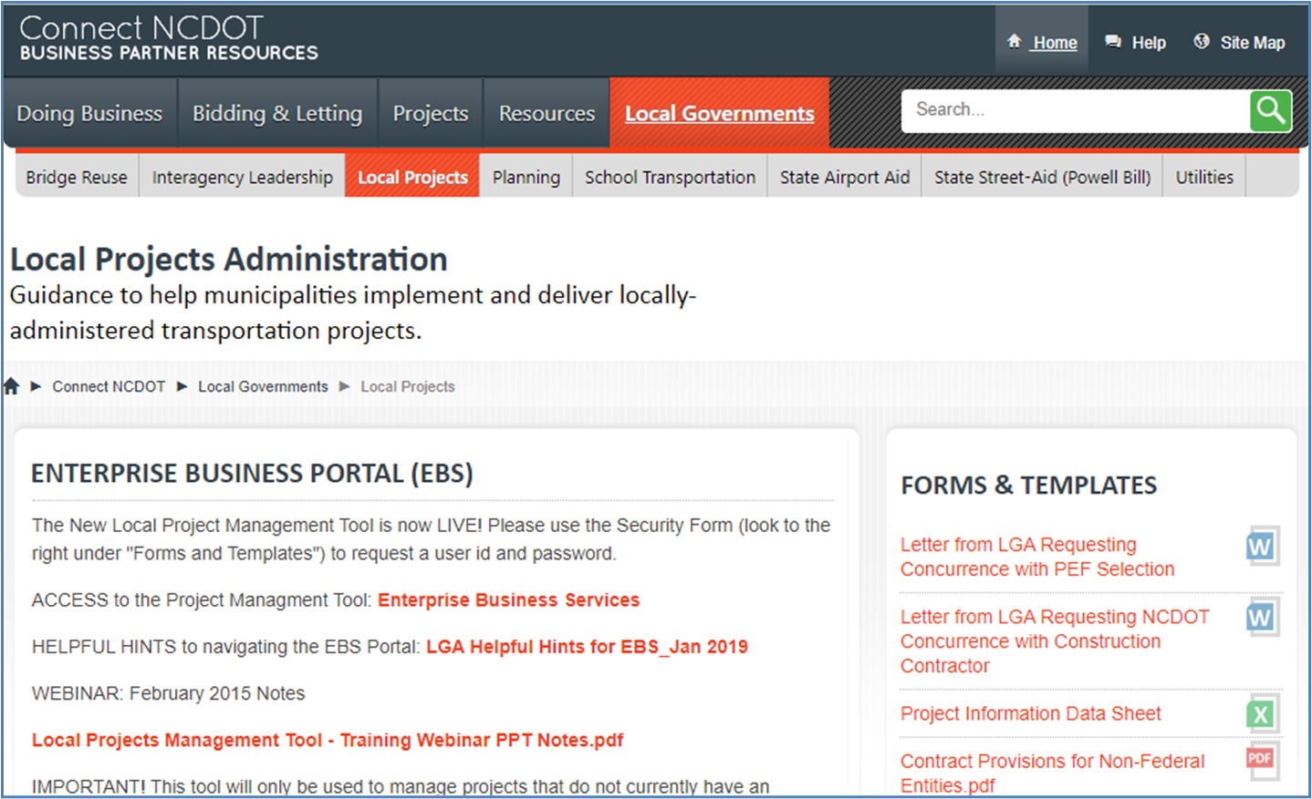
RESOURCES
https://connect.ncdot.gov/municipalities/Funding/Pages/default.aspx

Slide 24
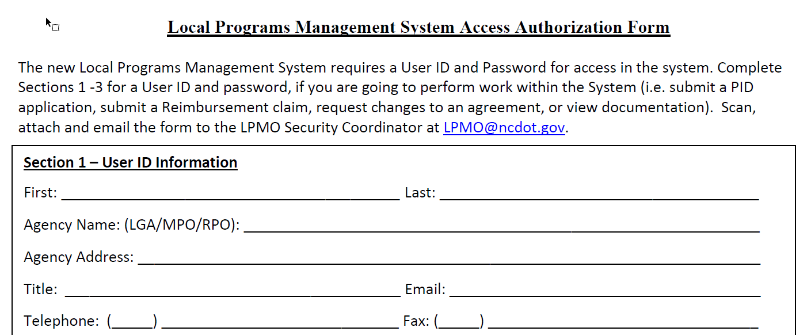
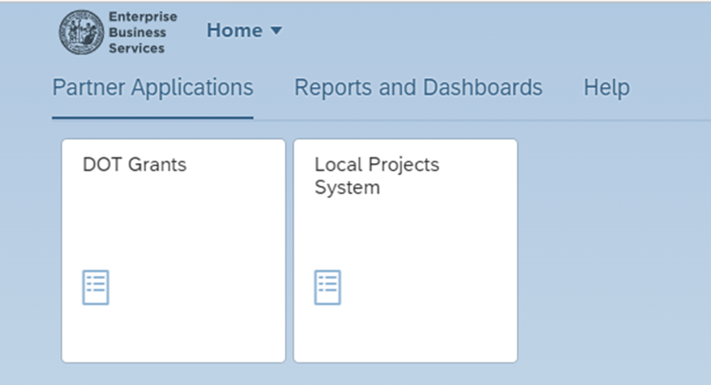
LOCAL PROJECT MANAGEMENT TOOL
The Project Management Tool on the EBS Portal will be used to:
Request New Agreements and Supplemental Agreements
Submit Documents for review by the Department
Request Funding Authorizations for each phase of work
Submit Reimbursement Requests for work performed

Slide 25
QUESTIONS?

Slide 26
Other slide variations are available. Select Insert above and choose “new slide” to see all the options.
DIVISION 5
Raymond Hayes, PE
Ext-rjhayes@ncdot.gov
919-628-8999 M
Local Programs Management Office
Sheila Gibbs
sbgibbs@ncdot.gov
DIVISION 7
919-707-6625 O
Stephen J. Robinson, PE
sjrobinson@ncdot.gov
336-487-0000 O

Slide 27
Other slide variations are available. Select Insert above and choose “new slide” to see all the options.

