Slide 1
Human Service Transportation 2008-2014
DCHC MPO
Services for Seniors, the low income, & Individuals w/ Disabilities
Durham – Chapel Hill – Carrboro Metropolitan Planning Organization
December 10, 2014

Slide 2
Presentation Overview
Introduction to Human Services Transportation
- What is Human Services Transportation?
- FTA Requirements
Grants utilized in the DCHC MPO
- Overview of JARC, New Freedom, & Section 5310 Grants
Grant Project Performance
- Regional impact
- Local government leverage
- Performance Metrics
Grant Projects on the Ground
- Examples of projects by sub-recipient
- Performance Measures (selected projects)

Slide 3
Introduction to Human Services Transit
DCHC MPO Coordinated Public Transit

Slide 4
Human Services Transit
Coordinated, Collaborative, & Diverse
"Human Services" is our term of convenience for a diverse network of publicly supported medical, educational, workforce development, and other social services.
"Public Transportation" refers to the entire family of transportation programs and services that are funded, or are eligible to be funded, with federal transit assistance, which include a wide range of public agencies, private nonprofits and for-profit transportation providers.
"Coordination" refers to all sorts of ways in which two or more entities agree to work together toward some common purpose.
National Resource Center for Human Service Transportation Coordination www.ctaa.org

Slide 5
FTA Requirements
Large Urbanized Areas
DCHC MPO Responsibilities
Develop coordinated public transportation plan – human service transportation plan
FTA designated recipient for human service related grants
Provide grant administration and technical support to sub-recipients
Hillsborough
Durham
Chapel Hill
Carrboro
RTP
DCHC MPO Boundary

Slide 6
FTA Human Services Grants
JARC
New Freedom
FTA 5310

Slide 7
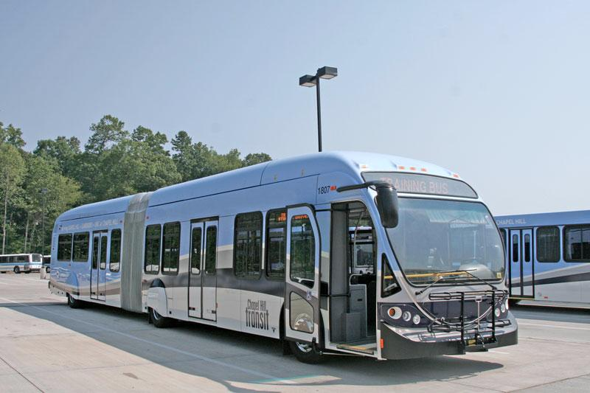
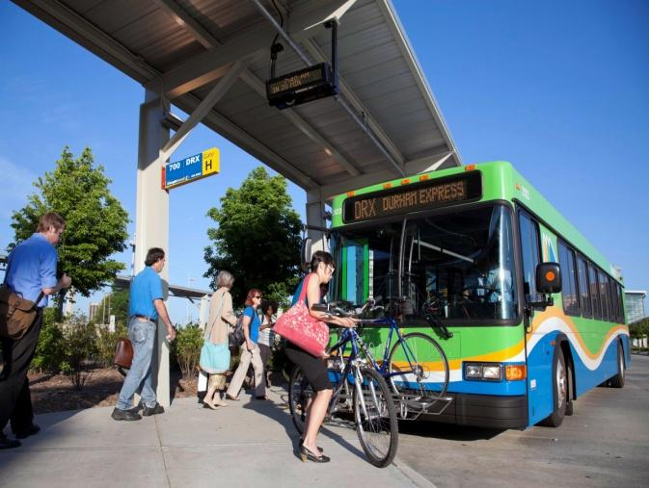
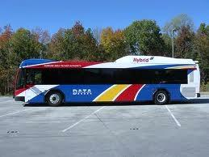
Job Access Reverse Commute (JARC 5316 Grant)*
Aims to address the transportation issues low-income individuals encounter accessing employment especially in suburban areas or during non-conventional work hours.
Goals:
Increase access to jobs in suburban areas.
Decrease transportation barriers to obtaining and maintaining employment.
* With the new federal transportation legislation MAP-21, the FTA repealed the JARC grant. JARC funds will be used in the DCHC MPO until the funds are exhausted. Currently, JARC-related activities can be funded through the FTA Section 5307 grant.

Slide 8
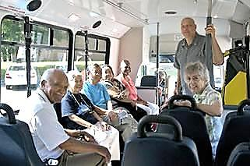
New Freedom Grant (FTA 5317)*
Aims to reduce barriers to transportation services and expand the mobility of persons with disabilities beyond the requirements of the Americans with Disabilities Act (ADA) of 1990.
Goals:
Increase integration of persons with disabilities into the workforce.
Expand mobility options.
Increase full participation in society.
* With the new federal transportation legislation MAP-21, FTA repealed the New Freedom grant. New Freedom funds will be used in the DCHC MPO until the funds are exhausted. Currently, New Freedom-related activities have been incorporated into the FTA Section 5310 grant.

Slide 9
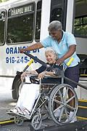
5310 Grant: Seniors & Individuals w/ Disabilities
Aims to improve mobility for seniors and individuals with disabilities by removing barriers to transportation services and expanding the transportation mobility options available.
Goals:
Increase public transit projects planned, designed, and carried out for seniors or persons with disabilities.
Improve access to fixed-route services and decrease reliance on paratransit.
Provide alternatives to public transit.
* With the new federal transportation legislation MAP-21, FTA has revised the 5310 grant. Currently, the 5310 grant incorporates activities once covered under the New Freedom (5317) grant.

Slide 10
Grant Project Performance
Measuring Regional Impact & Leverage

Slide 11
DCHC MPO JARC Projects
Grant Year Project Name Sub-recipient Total Cost Federal Share Local Share Expended *
LJA08 | Evening Service Extension | DATA | $203,138 | $100,000 | $103,138 | $100,000
LJA08 | Evening Service Extension | CHT | $101,098 | $50,549 | $50,549 | $50,549
LJA08 | New Hope Commons | DATA | $145,986 | $72,993 | $72,993 | $72,993
LJA09 | HS/Rogers Road Route | CHT | $169,936 | $84,968 | $84,968 | $84,968
LJA10 | NS & G Routes (night service) | CHT | $118,534 | $59,267 | $59,267 | $59,267
LJA11 | Durham County Access | Durham Co. | $239,858 | $119,929 | $119,929 | 0
LJA11 | Year-round Night Service | CHT | $291,332 | $145,666 | $145,666 | $84,094
LJA11 | HS/Rogers Road Route | CHT | $84,817 | $42,408 | $42,408 | $42,408
LJA13 | Elderly Travel & Work Trips | DATA/DCSL | $124,500 | $99,600 | $24,900 | 0
LJA13 | Year-round Night Service | CHT | $135,954 | $67,977 | 67,977 | 0
LJA13 | HS/Rogers Road Route | CHT | $73,416 | $36,708 | 36,708 | 0
LJA13 | Bier Creek - Route 15 | DATA | $189,392 | $94,696 | 94,696 | 0
LJA14 | Pittsboro Express (PX) Route | CHT | $197,572 | $98,786 | 98,786 | 0
LJA14 | Brier Creek- Rt. 15 (Expanded) | DATA | $461,270 | $230,635 | 230,635 | 0
LJA14 | HS/Rogers Road Route | CHT | $70,390 | $35,195 | 35,195 | 0
LJA14 | Sunday Routes (400, 700, & 800) | TTA | $470,736 | $235,368 | 235,368 | 0
*Federal share of grants expended as of June 30, 2014.
Figures do not include federal share of MPO administrative award of $157K. Awards for grants LJA13 and LJA14 were executed with FTA in June and September, 2014 respectively. Funds for LJA11 were re-allocated in March 2014 to current recipients.
Notes:
JARC Projects

Slide 12
DCHC MPO New Freedom Projects
Grant Year Project Name Sub-recipient Total Cost Federal Share Local Share Expended *
LNF08 | Paratransit Eligibility Assessment | DATA/TTA/CHT | $35,000 | $17,500 | $17,500 | $17,500
LNF08 | Senior Transit (feeder service) | CHT & OPT | 97,600 | 48,800 | 48,800 | 48,800
LNF09 | ACCESS Taxicab Medical Trip Program | DATA | 140,760 | 70,380 | 70,380 | 70,380
LNF09 | Elderly Travel Training/Mobility Management | Durham Center for Senior Life | 52,513 | 33,540 | 18,973 | 23,067
LNF09 | Regional Call Center | CHT | 50,614 | 40,491 | 10,123 | 40,491
LNF09 | Mobility Manager | CHT | 70,000 | 35,000 | 35,000 | 35,000
LNF11 | Regional Call Center | CHT | 132,000 | 66,000 | 66,000 | 66,000
LNF11 | ACCESS Taxicab Medical Trip Program | DATA | 109,200 | 54,600 | 54,600 | 54,600
LNF13 | Regional Call Center | DATA | 131,226 | 104,981 | 26,245 | 0
LNF13 | Elderly Travel Training/Mobility Management | Durham Center for Senior Life | 30,000 | 24,000 | 6,000 | 0
*Federal Share of grants expended as of June 30, 2014.
Figures do not include federal share of MPO administrative grant award of $42K.
Grant LNF13 was executed with FTA at current funding levels in June 2014.
Notes:
New Freedom Projects

Slide 13
DCHC MPO 5310 Projects*
FFY13 & FFY14 Apportionments
Project Name Sub-recipient Total Cost Fed. Share Local Share Expended**
EZ Rider Senior Shuttle | CHT | $216,000 | $108,000 | $108,000 | $ -
OnBoard Access | Durham County Access | $125,000 | $100,000 | $25,000 | $ -
Orange County STEAMM | Orange County Dept. on Aging | $162,500 | $130,000 | $32,500 | $ -
DATA ACCESS Mobility Management | DATA | $136,000 | $108,800 | $27,200 | $ -
**Federal share of grants expended as of June 30, 2014.
Grant application is awaiting FTA approval.
Figures do not include federal share of MPO administrative grant award of $28K.
Notes:
5310 Projects

Slide 14
JARC – Regional Impact 2008-14
JARC Grant Funds Programmed in DCHC MPO Region
2008-2014*
$3,077,929
$1,574,745
$1,503,183
$494,279
* Totals represent the full expenditure of grant funds at closeout.
** Federal Share of project costs expended through June 30, 2014, but not including MPO administrative costs reimbursed to date.
Figure in column 2 does not include federal share of MPO administrative costs of $157K.
Commitment of $1,503,183 local funds leveraged $1,574,745 federal funds.
Notes:
Columns 1, 2 and 3 include expended funds for closed grants and programmed funds for active grants. Column 4 is only expended funds through June 30, 2014.

Slide 15
New Freedom – Regional Impact 2008-14
New Freedom Grant Funds Programmed in DCHC MPO Region
2008-2014*
$ 848,913
$900,000
$500,000
$300,000
$ 495,292
$ 353,621
$ 355,838
*The totals represent the full expenditure of grant funds at grant closeout.
** Federal share of project costs expended through June 30, 2014, but not including MPO administrative costs reimbursed to date.
Figure in column 2 does not include federal share of MPO administrative costs of $42K.
Commitment of $353,621 in local funds leveraged $495,292 in federal funds.
Notes:
Columns 1, 2, 3 include expenditures for closed grants and programmed funds for active grants. Column 4 is federal funds expended through June 30, 2014, not including administrative MPO expenses.

Slide 16
The 5310 Grant – Regional Impact
5310 Grant Funds Programmed in DCHC MPO Region in 2014*
$ 667,890
$ 475,190
$ 192,700
* These grant projects were approved by the MPO in September 2014 and await FTA approval. Amounts include MPO administration funds.

Slide 17
FEDERAL SHARE Grant Totals By Sub-recipient
JARC $621,525
New Freedom $190,291
5310 $108,000
JARC $587,964
New Freedom $233,820
5310 $108,800
JARC $119,929
5310 $100,000
JARC $235,368
JARC $9,960
New Freedom $48,726
5310 $130,000
Notes:
Project Totals by sub-recipient. Totals include federal funds expended for closed grants plus funds programmed for active grants.

Slide 18
Performance Metrics
Performance Measure Terminology
MPO Evaluation Process
Performance Goal – a targeted level of performance expressed as a tangible measurable objective.
* Each project has to achieve at least one goal of its particular grant
Receive updates via quarterly reports.
Review grant applications for individual goals and indicators.
Compare grant application goals to actual grant indicators and other project accomplishments (annually).
Provide feedback to grantees and report findings to FTA.
Performance Indicators – quantitative value or characteristic used to measure outcomes.
Examples:
Ridership
Increases in service
Accessibility improvements
Quality of transportation services

Slide 19
Grant Projects on the Ground
Regional benefits to:
citizens
newcomers
visitors

Slide 20
MPO human services Projects
Employment Related Projects
Senior Focused Projects
Human Services Transit
Suburban job access
Late night service increases
Weekend service increases
Decrease barriers to jobs
Exceed ADA
Increase mobility
Increase access to fixed-route services
Decrease reliance on paratransit
Partnerships & Coordination
Persons w/ Disabilities Focused Projects
Regional Focus
Multiple Partners
Improve use of transit
Better leverage of funds
Exceed ADA
Increase mobility
Workforce transit

Slide 21
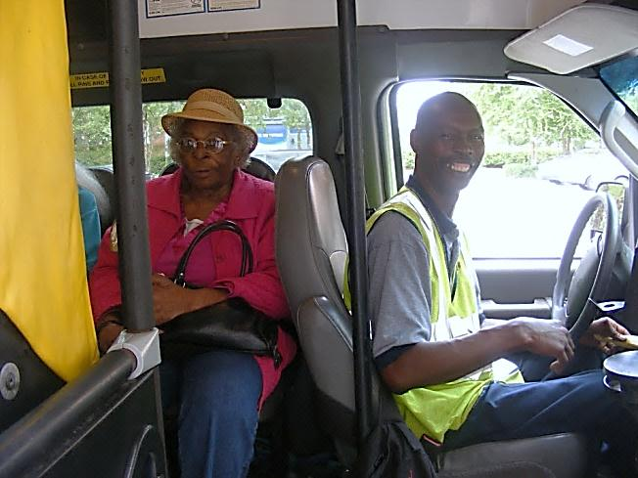
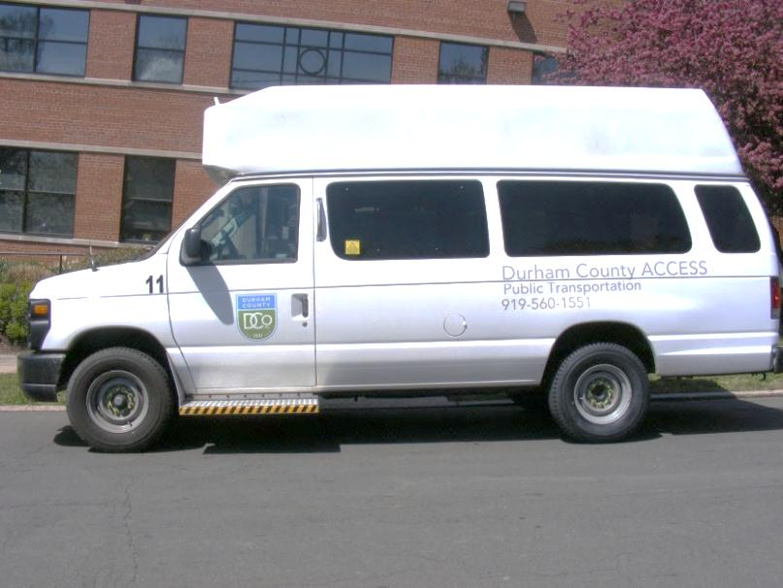
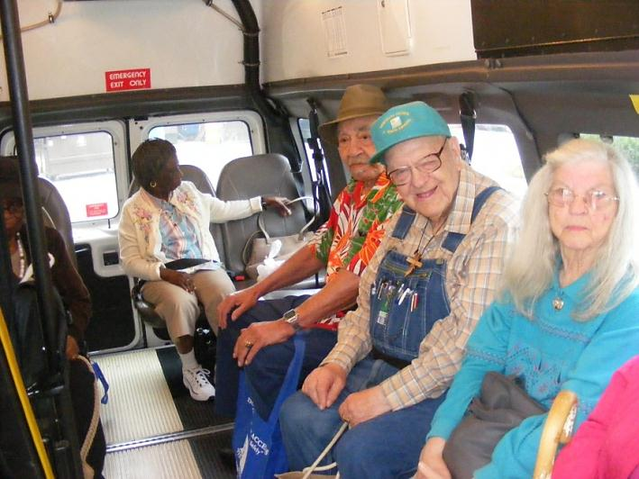
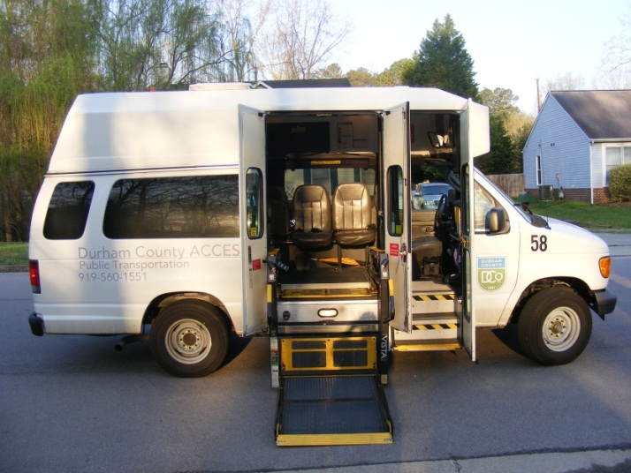
Persons w/ Disabilities focused Projects
Durham County ACCESS
Seniors & Individuals w/Disabilities
Project Totals
(Federal Share)
2008-2014
Examples:
Durham County ACCESS
$100,000
DATA Taxicab Medical Trip Program
$124,980
Notes:
DATA JARC 587,964 NF 229,961 5310 108,800

Slide 22
Partnerships & Coordination Projects*
GoTriangle Regional Call Center
Partners: TTA, CAT, CHT, DATA, & C-Tran
Project Totals
(Federal Share)
2008-2014
Examples:
Regional Call Center
$211,472
Paratransit Eligibility Assessment
$17,500
* Multiple recipients
per project
Notes:
CHT JARC 621,524 NF 190, 291 5310 108,00

Slide 23
GoTriangle Regional Call Center
Fiscal Year Performance Measurement for Phone Calls 2010-2014
95%
Answered
96%
Answered
94%
Answered
94%
Answered
98%
Answered
Performance Measure: 95% of calls answered
*There is no performance goal for the number of calls received.

Slide 24
Senior focused Projects
Durham Center for Senior Life
Bull City Golden Riders
Project Totals
(Federal Share)
2008-2014
Examples:
Orange County STEAMM
$130,000
DCSL Senior Travel Training
$58,686
Notes:
TTA JARC $235,368

Slide 25
Bull City Golden riders education & Accomplishments
72 Bus Club Members
140 Recipients of Travel Training
30⁺ Travel Training Field Trips
450⁺ Field Trip Attendees
Examples of Education & Travel Trips
Monthly bus club meetings
Individual travel training
Amtrak field trips from Durham to Cary & Greensboro
Training on route & service changes
Learning to read route maps
Traveling on TTA & connecting with CAT in Raleigh
DCSL hosted Public Transportation Awareness Day for Seniors & Individuals w/ Disabilities
Additional BCGR Accomplishments
BCGR Hotline
Partnership with TTA on route education & in-kind donations
BCGR members “adopted” a bus stop
Outreach/volunteering by BCGR seniors to community groups (travel via bus)
Instruction on how to download & use Transloc mobile app (for TTA buses)

Slide 26
Employment Related Projects
DATA
Brier Creek – RT. 15
Project Totals
(Federal Share)
2008-2014
Examples:
CHT- Rogers Rd.
$ 199,279
CHT- Year-Round Night Service
$213,643
DATA- Brier Creek & Expanded Hrs.
$325,331
DATA - New Hope Commons Route
$72,993
Notes:
DATA JARC 587,964 NF 229,961 5310 108,800

Slide 27
DATA Route 15 – Brier Creek
151*
103
Performance Measure: 44,064 Yearly Ridership (for expanded service starting in 2014)
Performance Measure: 144 Average Daily Ridership (for expanded service starting in 2014)
*2014 (January-November). JARC funds have been used to support the base service since July 2014
and the expansion of the service since September 2014.
**Route 15 doubled daily trips from 9 to 18 in 2014. Ridership increased 21.7% between 2013 and 2014 (Jan-Nov).

Slide 28
Chapel hill transit – ns & G routes
Annual Ridership (extended evening service only)
Performance Measure Annual Ridership: NS Route 25,100 G Route 10,793

Slide 29
Questions?

